Slide 1

WEB TECHNOLOGIES – LECTURE 15
UNIVERSITÀ DEGLI STUDI DI NAPOLI FEDERICO II
THE REST PARADIGM
Luigi Libero Lucio Starace, PhD
luigiliberolucio.starace@unina.it
https://luistar.github.io
https://www.docenti.unina.it/luigiliberolucio.starace

Slide 2
PREVIOUSLY, ON WEB TECHNOLOGIES
In the last lecture, we developed a full-fledged web app with Express
Our app took care of everything on the Server:
It managed data (with the Sequelize ORM)
It managed business logic (with routes, controllers, middlewares, sessions)
It managed presentation (rendered templates using Pug)
Browsers were only responsible for visualizing HTML pages
HTTP Request
Web Application
Browser
Presentatio
n
Logic
Data
HTML Document

Slide 3
‘TRADITIONAL’ WEB APPS
This approach is often referred to as «traditional» web apps
Originated when Browsers had limited capabilities and Web content was generally accessed only via Browsers
Nowadays, the scenario is more complex
Data might need to be accessed also by other software (e.g.: mobile apps)
Trend is to exploit the capabilities of modern browsers to deliver a more reactive user experience (i.e., single page apps - we’ll see in a few lectures)
Browser
Web Application
Presentation
Logic
Data
Native Apps

Slide 4
‘TRADITIONAL’ WEB APPS
Traditional web apps are not flexible enough in some modern scenarios
Other software willing to access data has to
Download the HTML pages
Parse and analyze them to extract relevant data
Not very efficient: transfer a lot of unneded data
Not very robust: any change in the HTML pages might break the extraction of the data

Slide 5

THE CURRENT TREND
Current trend is to split web applications in two components:
Backend: Responsible for data and business logic (on the server-side)
Frontend: Responsible for the UI (on the client-side)
Might be a native mobile or desktop app
Or it might still be a «smarter» HTML page, that renders an interactive UI leveraging JavaScript (i.e., Single Page Web Apps)
These two components communicate over the internet
Frontend (client-side)
Backend (server-side)
Internet

Slide 6
ARCHITECTURAL CONTEXT
Software needs to communicate over the Internet
83% of web traffic is actually API calls¹
Clients
Android App
request
Application Server A
response
Application
Database
iOS App
Java Swing App
request
response
Web Page
Application Server B
Angular
App
Command
Line Tool
Application
Database
[1] Akamai’s State of the Internet Security Report (2019)
https://www.akamai.com/newsroom/press-release/state-of-the-internet-security-retail-attacks-and-api-traffic
6

Slide 7
APPLICATION PROGRAMMING INTERFACES
Application Programming Interfaces (APIs) are ways for computer programs to communicate with each other
How can we handle communications over the internet?
Manually define a protocol over TCP/UDP, open sockets, etc…
Not very cost-effective, not very interoperable
If we want to integrate n APIs, we’ll need to learn n different protocols
CORBA, Java RMI, SOAP, …
Dedicated protocols/architectures exist(ed), re-inventing an alternative to the web
Just use web protocols (HTTP)!

Slide 8
REST
REST is not a standard or a protocol
REST is an architectural style: a set of principles and guidelines that define how web standards should be used in APIs
Based on HTTP and URIs
Provides a common and consistent interface based on «proper» use of HTTP
The prevalent web API architecture style with a 93.4% adoption rate¹
[1] https://nordicapis.com/20-impressive-api-economy-statistics/

Slide 9
REST FUNDAMENTALS
A REST API allows to interact with resources using HTTP
All resources are associated to a unique URI
«A resource is anything that’s important enough to be referenced as a thing in itself.»¹
Resource typically (but not necessarily) correspond to persistent domain objects
HTTP verbs should be used to retrieve or manipulate resources
REST API should be stateless (e.g.: not use server-side sessions)
This ensures better scalabilty! Can you tell why?
[1] Richardson, Leonard, and Sam Ruby. RESTful web services. "O'Reilly Media, Inc.", 2008.

Slide 10
REPRESENTATIONAL STATE TRANSFER (REST)
Application State (on the Client)
Resource State (on the Server)
Trasferred using appropriate representations (e.g.: JSON, XML, …)
GET /todos
HTTP/1.1
Client
Server
[{"todo": "A"}, {"todo": "B"}, ...]

Slide 11
HTTP: DATA INTEREXCHANGE FORMATS
Widely used formats include JSON and XML
{
"todos": [{
"todo": "Learn REST", "done": false
}, {
"todo": "Learn JavaScript",
"done": true
}]
}
<?xml version="1.0" encoding="UTF-8" ?>
<root>
<todos>
<todo>
<text>Learn REST</text>
<done>false</done>
</todo>
<todo>
<text>Learn JavaScript</text>
<done>true</done>
</todo>
</todos>
</root>

Slide 12
REST: EXAMPLES
HTTP verb/URI | Meaning
GET /todos | Retrieve a list of all saved To-do items
GET /todos/<ID> | Retrieve only the To-do item whose ID is <ID>
POST /todos | Save a new To-do item. Data of the exam to save are in the request body
PUT /todos/<ID> | Replace (or create) the To-do item whose ID is <ID>, using the data in the request body
DELETE /todos/<ID> | Delete the To-do item having ID <ID>

Slide 13
REST: NESTED RESOURCES
Sometimes, there is a hierarchy among resources
A Company has 0..* Departments which have 0..* Employees…
When designing an API, it is possible to define nested resources
GET /seller/{id}/reviews lists all the reviews of a given seller.
Keep in mind that every resource should have only one URI

Slide 14
IMPLEMENTING A REST API
REST APIs are conceptually simple
We just need to listen for HTTP requests, and handle them
Once done handling the request, we send a HTTP response
That’s the same things we already did with our traditional web app!
Instead of responding with an HTML representation to be rendered in a browser, we use a more machine-friendly representation (e.g. JSON)
Instead of getting input via form submissions, we get inputs in a machine- friendly representation (e.g.: JSON)
We should not rely on sessions, and other authentication schemes should be put in place

Slide 15
SECURING A REST API
The JSON Web Token (JWT) Authentication/Authorization Scheme

Slide 16
API AUTHENTICATION/AUTHORIZATION
REST APIs allow users to manipulate resources
In most cases, we don’t want everyone to be able to do so
Authentication: We want that only legit users can access the resources
Authorization: We may also want that some users can access only certain resources (e.g.: an employee shouldn’t be able to update its own salary)

Slide 17

HOW TO SECURE REST APIS
A widely-used authentication scheme is based on Tokens Idea:
Clients send a request with username and password to the API
API validates username and password, and generates a token
The token (a string) is returned to the client
Client must pass the token back to the API at every subsequent request that requires authentication (in the Authorization Header)
API verifies the token before responding

Slide 18
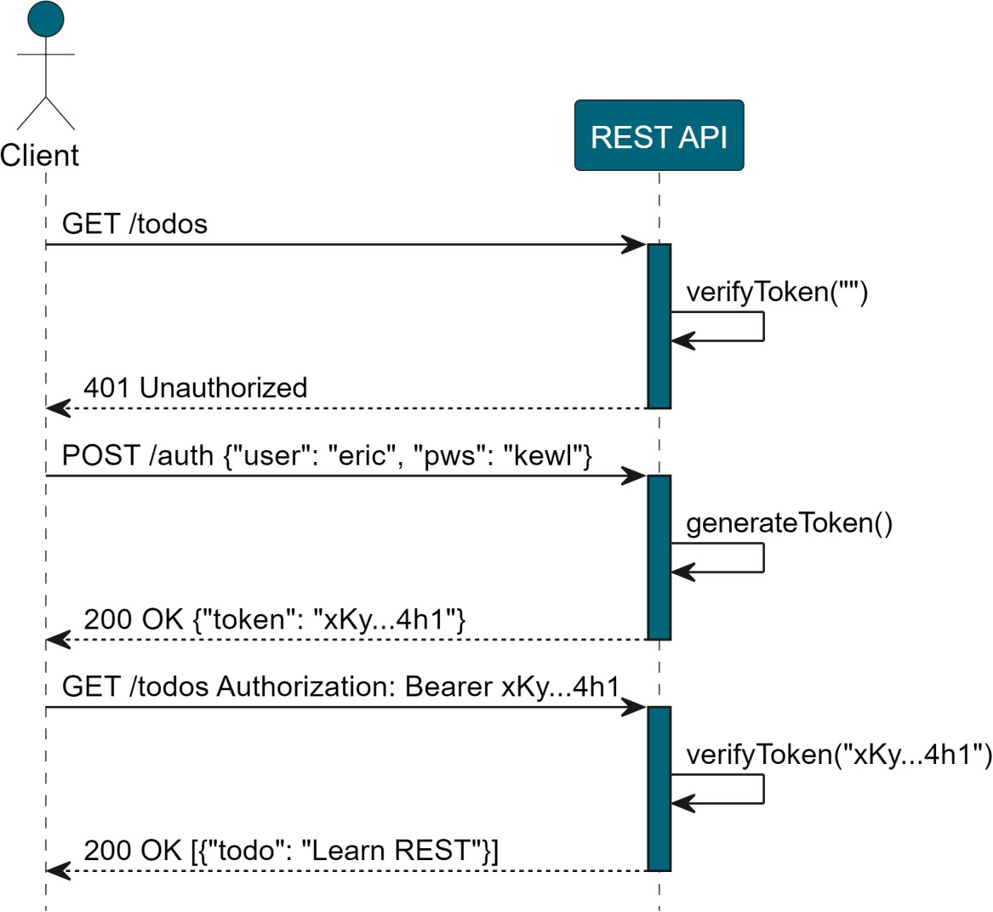
TOKEN-BASED AUTHENTICATION SCHEME
Request with no token in the authorization header
Authentication Request
Request with valid token
18

Slide 19
JSON WEB TOKEN (JWT)
JWT is a widely-adopted open standard (RFC 7519)
Allows to securely share claims between two parties
A JWT token is a string consisting of three parts, separated by “.”
Structure: Header.Payload.Signature
eyJhbGciOiJIUzI1NiIsInR5cCI6IkpX VCJ9.eyJuYW1lIjoibHVpZ2kiLCJyb2x lIjoiYWRtaW4iLCJleHAiOjE2NzAzOTg 0MzJ9.fopBYrax8wcB7rnPjCcOMc62IT 2lJdvyOdyixMWMZAQ
19

Slide 20
JWT: HEADER
The JWT header contains information about the type of token and the type of hashing function used to sign it, in JSON format
It is encoded using Base64Url Encoding
Note that this is merely an encoding, not an encryption! It can be easily be inverted!
eyJhbGciOiJIUzI 1NiIsInR5cCI6Ik pXVCJ9
{
"alg": "HS256",
"typ": "JWT"
}
Base64Url Encoding
20

Slide 21
JWT: PAYLOAD
The payload is a JSON object containing claims
Some registered claims are recommended (e.g. «exp» indicates an expiration date for the token)
Claims are customizable (we can write any claim in the payload)
It is encoded using Base64Url Encoding
eyJuYW1lIjoibHV pZ2kiLCJyb2xlIj oiYWRtaW4iLCJle HAiOjE2NzAzOTg0 MzJ9
{
"name": "luigi",
"role": "admin", "exp": 1670398432
}
Base64Url Encoding
21

Slide 22
JWT: SIGNATURE
To ensure that tokens are not tampered or forged, a signature is included
The signature is obtained by applying a cryptographic hashing function to the string obtained by concatenating:
The header of the token
The payload of the token
A secret key known only by the server that issues the token
Actually, JWT signatures are a little bit more complex than that
Check out HS256 or RS256 if you want to know more: https://auth0.com/blog/rs256-vs-hs256-whats-the-difference/

Slide 23
CRYPTOGRAPHIC HASHING FUNCTIONS
Functions that map an arbitrary binary string (input) to a fixed-size binary string (digest or hash)
Web Technologies
Cryptographic Hashing Function (SHA2-256)
72bdf1226df1010dfb47cffaed85f5b35ae15ec9b482388691fa7a662a114113
Web Technologies!
1a6791a2eab52c7c71d3e1225632d866b48a3abad91df15b2d44ab6004877993
Secure cryptographic hashing funcs have some interesting properties:
They are virtually collision free (basically it’s impossible to find two different inputs that lead to the same digest)
They can be computed easily, but cannot be inverted
Given an input, it is easy to compute its digest. But given a digest, it’s unfeasible to compute the input that generated it

Slide 24
JSON WEB TOKEN: OVERVIEW
eyJhbGciOiJIUzI 1NiIsInR5cCI6Ik pXVCJ9.eyJuYW1l IjoibHVpZ2kiLCJ yb2xlIjoiYWRtaW 4iLCJleHAiOjE2N zAzOTg0MzJ9.fop BYrax8wcB7rnPjC cOMc62IT2lJdvyO dyixMWMZAQ
{
"alg": "HS256",
"typ": "JWT"
}
Base64Url Encoding
{
"name": "luigi",
"role": "admin", "exp": 1670398432
}
Base64Url Encoding
HMACSHA256(
base64UrlEncode(header) + "." + base64UrlEncode(payload), secret_key
)
24

Slide 25
TO-DO LIST REST API WITH EXPRESS
25

Slide 26

A REST API USING EXPRESS
We will implement a REST API for our To-do list app
We will use Express, and re-use most of the code from our Express To-do List web app
Let’s take a look at the code!
Code available in Course Materials
The following slides show some highlights from the demo.
26

Slide 27
CONFIGURING MIDDLEWARES
const app = express();
const PORT = 3000;
// Register the morgan logging middleware, use the 'dev' format app.use(morgan('dev'));
app.use(cors()); //API will be accessible from anywhere. We'll talk about this in
Lecture 23!
// Parse incoming requests with a JSON payload app.use(express.json());
27

Slide 28
ERROR HANDLING
//error handler
app.use( (err, req, res, next) => { console.log(err.stack); res.status(err.status || 500).json({
code: err.status || 500,
description: err.message || "An error occurred"
});
});
28

Slide 29
AUTHENTICATION: ROUTES
authenticationRouter.post("/auth", async (req, res) => {
let isAuthenticated = await AuthController.checkCredentials(req, res); if(isAuthenticated){
res.json(AuthController.issueToken(req.body.usr));
} else {
res.status(401);
res.json( {error: "Invalid credentials. Try again."});
}
});
authenticationRouter.post("/signup", (req, res, next) => {
AuthController.saveUser(req, res).then((user) => { res.json(user);
}).catch((err) => {
next({status: 500, message: "Could not save user"});
})
});

Slide 30
AUTHENTICATION: JWT
import Jwt from "jsonwebtoken";
static issueToken(username){
return Jwt.sign({user:username}, process.env.TOKEN_SECRET, { expiresIn: `${24*60*60}s`
});
}
static isTokenValid(token, callback){
Jwt.verify(token, process.env.TOKEN_SECRET, callback);
}

Slide 31
AUTHENTICATION: MIDDLEWARE
export function enforceAuthentication(req, res, next){ const authHeader = req.headers['authorization'] const token = authHeader?.split(' ')[1]; if(!token){
next({status: 401, message: "Unauthorized"}); return;
}
AuthController.isTokenValid(token, (err, decodedToken) => {
if(err){
next({status: 401, message: "Unauthorized"});
} else {
req.username = decodedToken.user; next();
}
});
}
31

Slide 32
ENFORCING AUTHORIZATION
In our API, we want users to be able to modify and visualize only their own To-do items!
What if an user tries to send a DELETE request for a To-do item that does not belong to him?
We should also check that the client actually has permission to interact with a resource!
32

Slide 33
AUTHORIZATION MIDDLEWARE
export async function ensureUsersModifyOnlyOwnTodos(req, res, next){
const | user = req.username;
const | todoId = req.params.id;
const | userHasPermission = await | AuthController.canUserModifyTodo(user, | todoId);
if(userHasPermission){ next();
} else {
next({
status: 403,
message: "You are forbidden to view or modify this resource"
});
}
}
33

Slide 34
AUTHORIZATION MIDDLEWARE
Example of sensible route protected with the authorization middleware
todoRouter.get("/todos/:id", ensureUsersModifyOnlyOwnTodos, (req, res, next) => {
TodoController.findById(req).then( (item) => {
if(item) res.json(item);
else
next({status: 404, message: "Todo not found"});
}).catch( err => {
next(err);
})
});

Slide 35

OPENAPI: DESCRIBING A REST API
OpenAPI (formerly Swagger) is an open, formal standard to describe HTTP APIs
Why?
Standardization: ensures consistent documentation practices
Documentation: can be used to automatically generate comprehensive docs
Code generation: Allows for automatic generation of client libraries and server stubs
Machine and human-readable: enables automated discovery and more
Most broadly adopted industry standard

Slide 36
THE OPENAPI SPECIFICATION
OpenAPI Descriptions are written as structured text documents
Each document represents a JSON object, in JSON or YAML format
These specification files describe version of the OpenAPI specification (openapi), the API (info) and the endpoints (paths)
# YAML format openapi: 3.1.0 info:
title: A minimal specification version: 0.0.1
paths: {} # No endpoints defined
// JSON format
{
"openapi": "3.1.0", "info": {
"title": "A minimal specification",
"version": "0.0.1"
},
"paths": {} // No endpoints defined
}

Slide 37
THE OPENAPI SPECIFICATION: PATHS
The API Endpoints are called Paths in the OpenAPI specification
Path objects allow to specify a sequence of endpoints
For each endpoint, its supported methods
For each method,
Expected input parameters (if any) (e.g.: path parameters, headers, etc…)
Request body (if any)
Possible responses
And more!

Slide 38
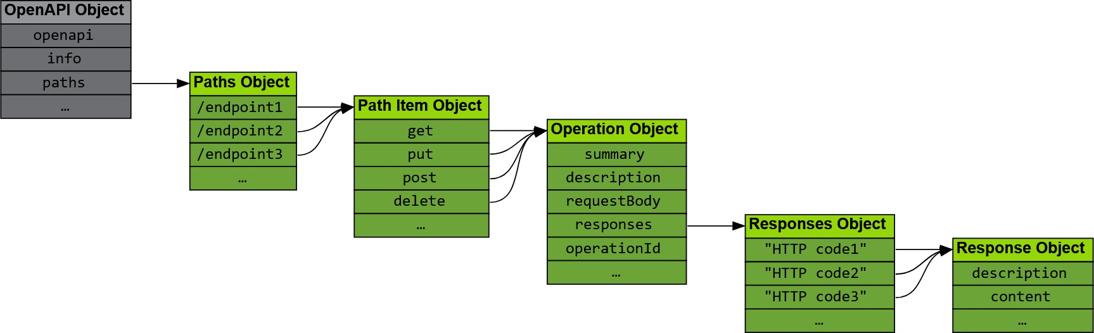
THE OPENAPI SPECIFICATION: PATHS
Image from https://learn.openapis.org/specification/paths
38

Slide 39
PATH EXAMPLE
/auth:
post:
description: Authenticate user produces:
- application/json requestBody:
description: user to authenticate
required: true content:
application/json: schema:
type: object
properties: usr:
type: string example: Kyle
pwd:
type: string example: p4ssw0rd
responses: 200:
description: User authenticated
401:
description: Invalid credentials
/auth endpoint, POST method
Expects Request Body containing a JSON object with type {usr: string, pwd: string}
Returns 200 OK on success, 401 Unauthorized when credentials are invalid
39

Slide 40
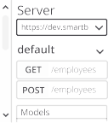


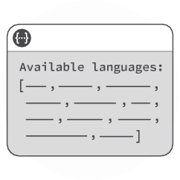
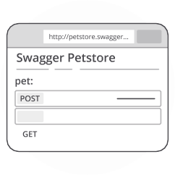

WORKING WITH OPENAPI SPECIFICATIONS
Writing an OpenAPI specification for an API is quite a lot of work
What can we do with an OpenAPI specification?
openapi: 3.1.0 info:
title: My API
version: 1.0.0
paths:
/auth:
post:
# ...
/todos:
get:
# ...
post:
# ...
Design Support
Detect errors and inconsistencies
Generate Code
Server stubs, client SDKs, tests
Document
Generate interactive docs
40

Slide 41
OPENAPI: OPEN SOURCE TOOLS
OpenAPI is supported by a number of mature, open-source tools
Some widely used open-source tools are reported as follows:
Swagger Editor: https://swagger.io/tools/swagger-editor/
Swagger Codegen: https://swagger.io/tools/swagger-codegen/
Swagger UI: https://swagger.io/tools/swagger-ui/
You can also check them out in a web browser, without downloading anything: https://editor.swagger.io/
41

Slide 42
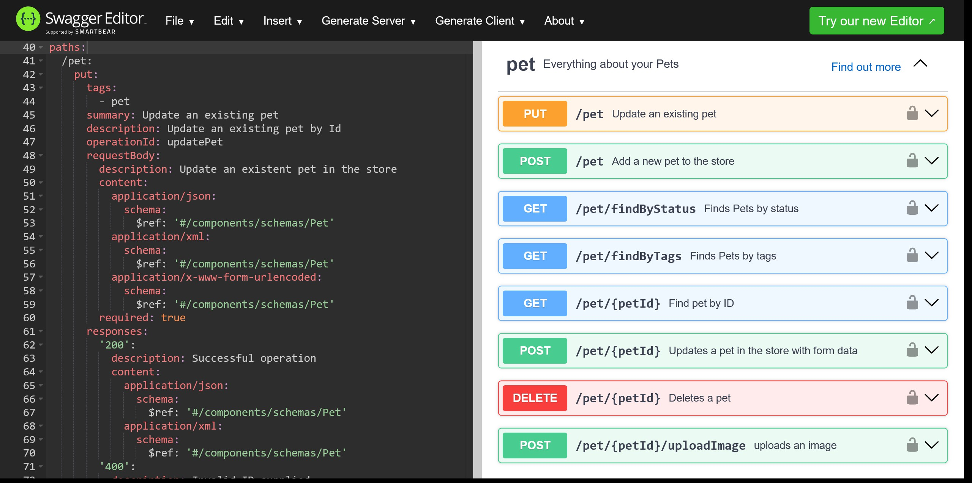
OPENAPI: SWAGGER EDITOR
Specification
Documentation (Swagger UI)

Slide 43
OPENAPI: CODEGEN
From the editor toolbar, we can also generate Server and Client code
Server-side code generation can obviously only provide stubs
Supported languages/frameworks include: ASP.NET, Go, Java, JaxRS, Micronaut, Kotlin, Node.js, Python (Flask), Scala, Spring.
Client-side code generation is a very handy way to make SDKs for our APIs available in tens of different languages
Supported languages include: C#, Dart, Go, Java, JavaScript, Kotlin, PHP, Python, R, Ruby, Scala, Swift, TypeScript

Slide 44
OPENAPI-DRIVEN DEVELOPMENT
Often, developers start working on an API by defining its specification before writing any actual code
This approach is also referred to as OpenAPI-driven development
This way, they can exploit code generation capabilities to the fullest
The approach also promotes independence between the different teams involved in a project (front-end, back-end, QA). The API definition keeps all these stakeholders aligned

Slide 45
GENERATING OPENAPI SPECS FOR OUR API
We will use two Node packages
swagger-jsdoc: automatically generates OpenAPI specifications based on annotations in our source code.
swagger-ui-express: serves automatically generated Swagger UI
documentation from Express, using an existing OpenAPI specification file (we’ll use the one generated by swagger-jsdoc.
@luigi ➜ express-hello-world $ npm install swagger-jsdoc @luigi ➜ express-hello-world $ npm install swagger-ui-express

Slide 46
GENERATING OPENAPI SPECS FOR OUR API
// generate OpenAPI spec and show Swagger UI
// Initialize swagger-jsdoc -> returns validated Swagger spec in json format const swaggerSpec = swaggerJSDoc({
definition: { openapi: '3.1.0', info: {
title: 'To-do List REST API', version: '1.0.0',
},
},
apis: ['./routes/*Router.js'], // files containing annotations
});
//Swagger UI will be available at /api-docs
app.use('/api-docs', swaggerUI.serve, swaggerUI.setup(swaggerSpec));

Slide 47
GENERATING OPENAPI SPECS FOR OUR API
/**
* @swagger
/auth:
post:
description: Authenticate user
requestBody:
content:
application/json:
schema:
type: object
properties:
usr:
type: string
pwd:
type: string
Note: Some parts of the Path
specification were omitted for the sake of brevity
*/
authenticationRouter.post("/auth", async (req, res) => {/*...*/});

Slide 48
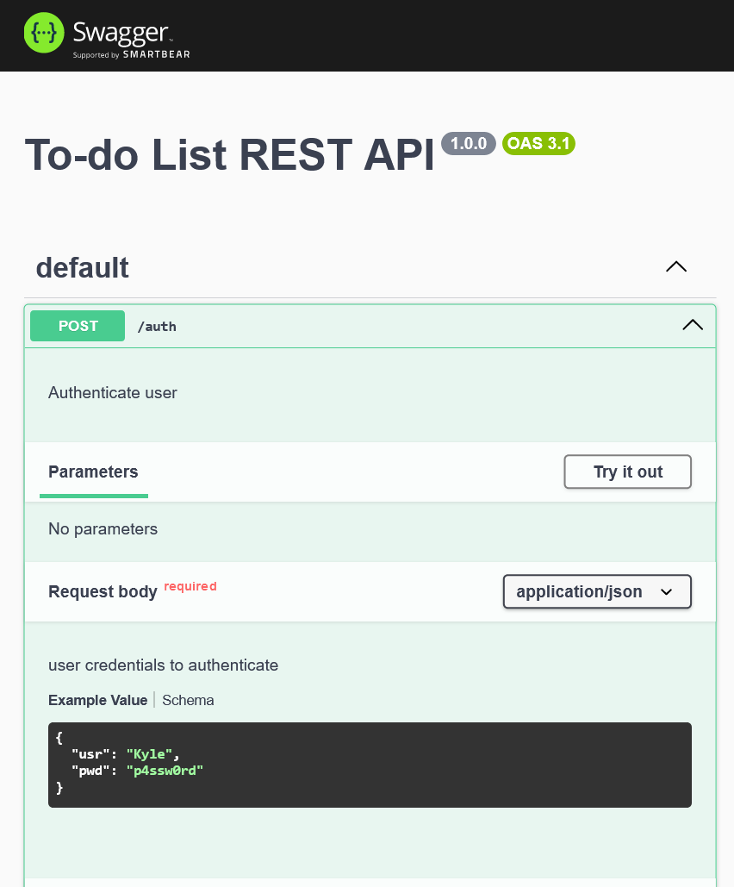
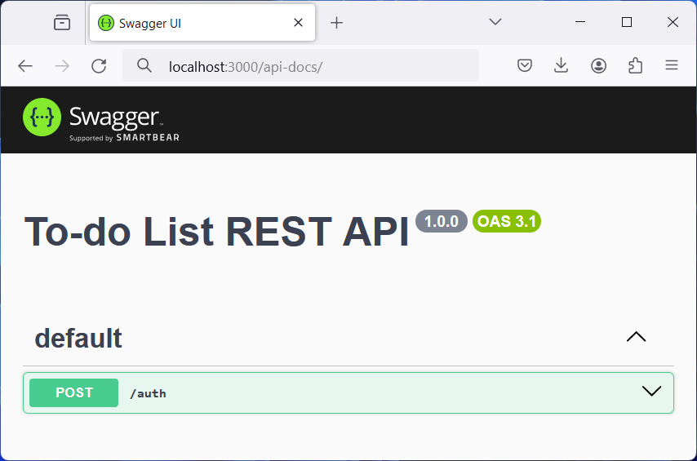
GENERATING OPENAPI SPECS FOR OUR API

Slide 49
REFERENCES (1/2)
The Little Book on REST Services
By Kenneth Lange
Freely available at https://www.kennethlange.com/books/The-Little-Book-on-REST-Services.pdf
API design guide
Google Cloud
https://cloud.google.com/apis/design
Relevant parts: Resource-oriented design, Resource names.
REST API Checklist
By Kenneth Lange https://kennethlange.com/rest-api-checklist/

Slide 50

REFERENCES (2/2)
OpenAPI
Official Website https://www.openapis.org/
https://learn.openapis.org/ (Recommended reads from this link: Getting started, Introduction) https://spec.openapis.org/oas/v3.1.0 (Full specification for OpenAPI 3.1.0)
For the Web Technologies course, you need to know what the OpenAPI specification standard is, why it
has been introduced, and what it can be used for. You are not required to learn how to write OpenAPI
specification files from scratch.
API Documentation: The Secret to a Great API Developer Experience
Ebook by Smartbear Software
Available at https://swagger.io/resources/ebooks/api-documentation-the-secret-to-a-great-api-developer-
experience and archived here.
Interesting read. Not required for the Web Technologies course, but it can be useful to better understand the challenges in designing and documenting an API.

Slide 51

EXAMPLES WITH DIFFERENT FRAMEWORKS
To-do List REST API using JakartaEE (Java)
By Luigi Libero Lucio Starace
Includes source code, Dockerfile and instructions. https://github.com/luistar/jakartaee-rest-example
Pizza Shop REST API using Spring (Java)
By Luigi Libero Lucio Starace
https://github.com/luistar/rest-service-pizzashop
Quiz REST API using FastAPI (Python)
By Márcio Lemos
https://github.com/marciovrl/fastapi
You are not required to learn JakartaEE, Spring, or FastAPI for the Web Technologies course. It might be educationally worthwhile to take a look at some web frameworks other than Express. JakartaEE and Spring, for example, use an annotation-based approach. So, feel free to look at the code or try to run the above linked REST API, but be aware that it’s not required for this course.

